Slide 1
Exercise 5
BIOENG-310: Neuroscience Foundations for Engineers
Yingtian Tiang
Alejandro Rodriguez Guajardo
Aude Maier

Slide 2
Context of the Exercise
We will use a dataset from Freeman & Ziemba, 2013, a study on V1 and V2 responses to visual textures in macaque monkeys.
Objective: Learn how to manipulate and interpret neural response data.

Slide 3
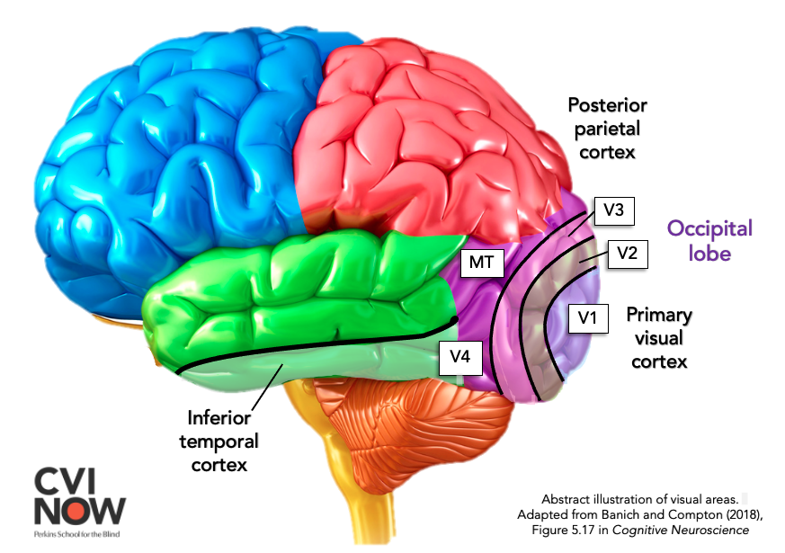
Overview of visual cortex V1 and V2
V1 → Detects basic visual features: edges, orientation, contrast. Simple feature detection
V2 → Builds on V1 information to detect textures and complex patterns.

Slide 4
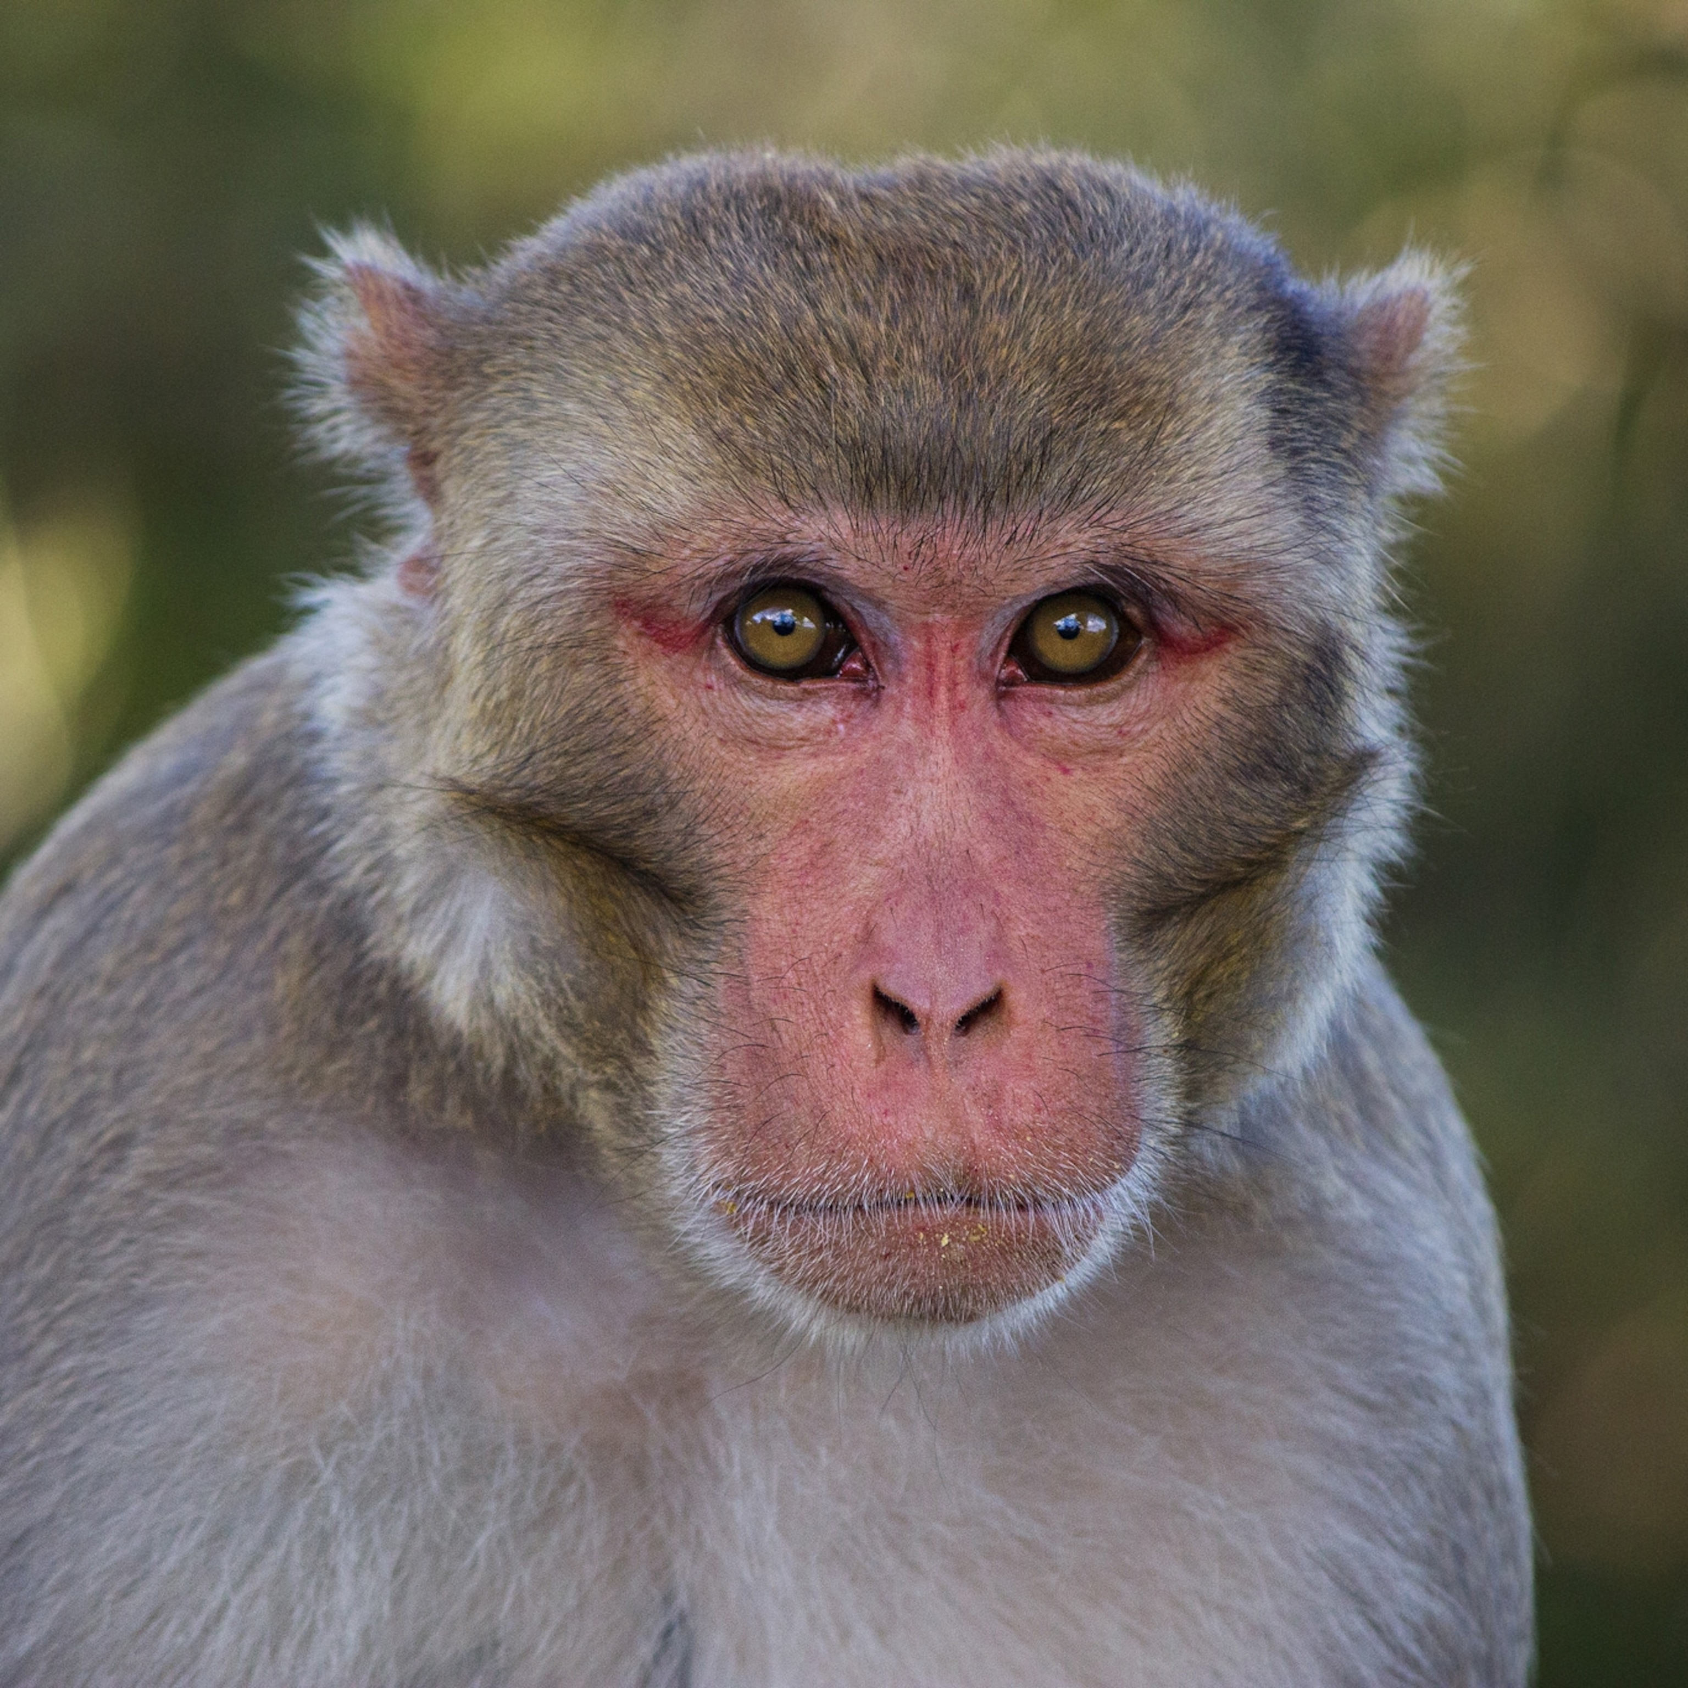
Experimental Methodology
Subjects: Macaque monkeys.
Stimuli: Synthetic images were generated to match natural textures or contain randomized noise.

Slide 5
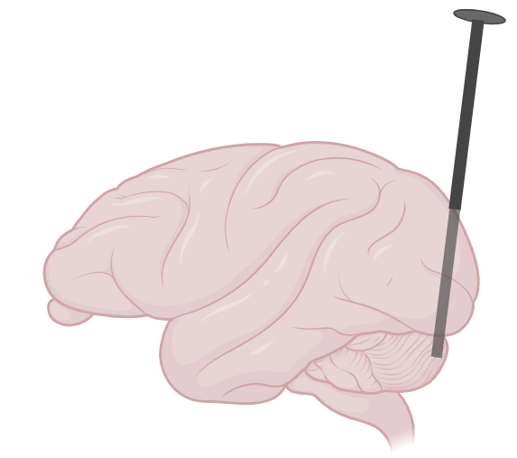
Experimental Methodology
Electrophysiological recordings:
Several microelectrodes implanted in the V1 and V2 cortex.
These electrodes are used to record Local Field Potentials (LFP).
102 recording sites!

Slide 6
The Dataset
Data by Freeman & Ziemba et al. 2013, packaged into the Brain-Score platform.
300
ms of time
102
neural recording sites
2700
Repetitions of the experiment (Presentations)
Key Question: How do V1 and V2 respond differently to naturalistic textures?

Slide 7
Objectives
Download the dataset
Access and visualize the different stimulus
Access and visualize the neural data
Apply Linear readout / linear probing to sort the data

Slide 8
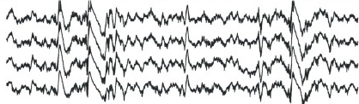
Retrieve image type from LFP

Slide 9
Train linear classifier
Texture
Noise
Texture

Slide 10
Questions?

